Slide 2
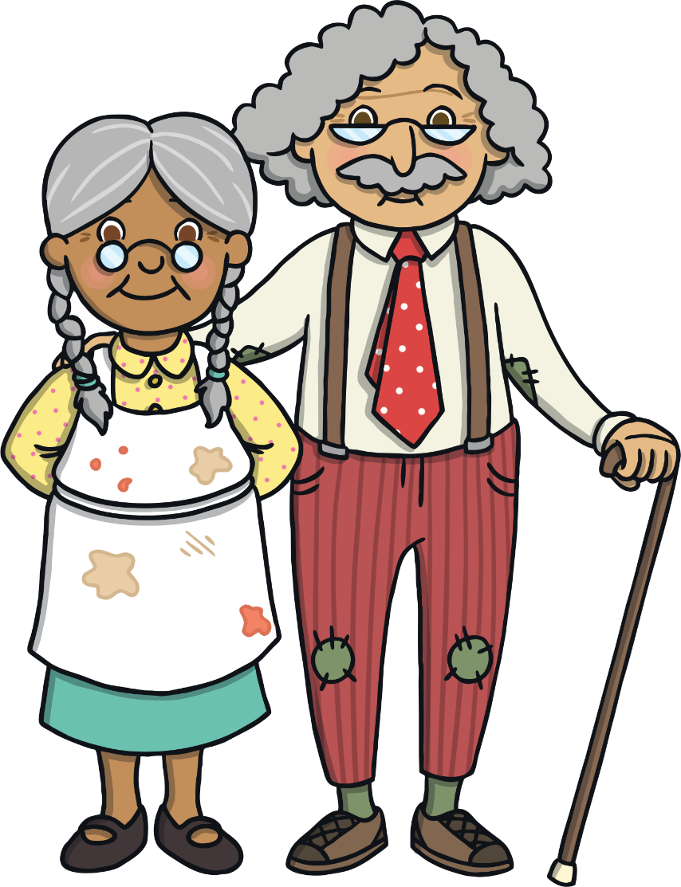
Once upon a time, there lived a little old woman and a little old man.

Slide 3
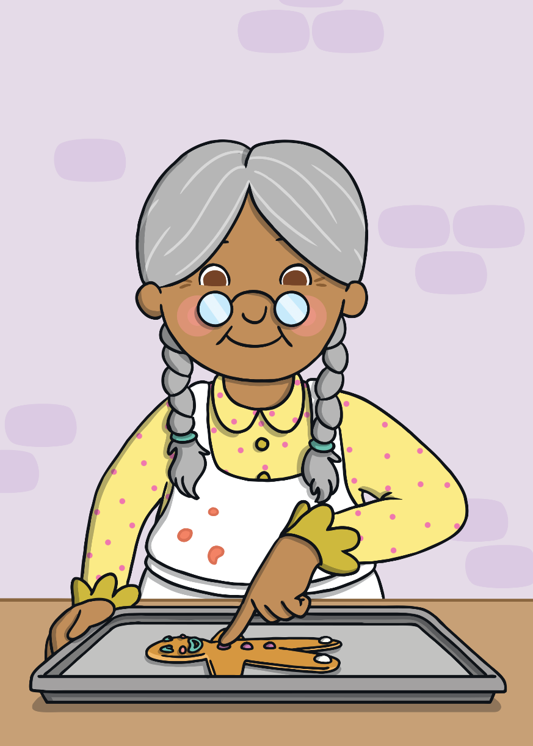
One day, the little old woman made a gingerbread man.

Slide 4
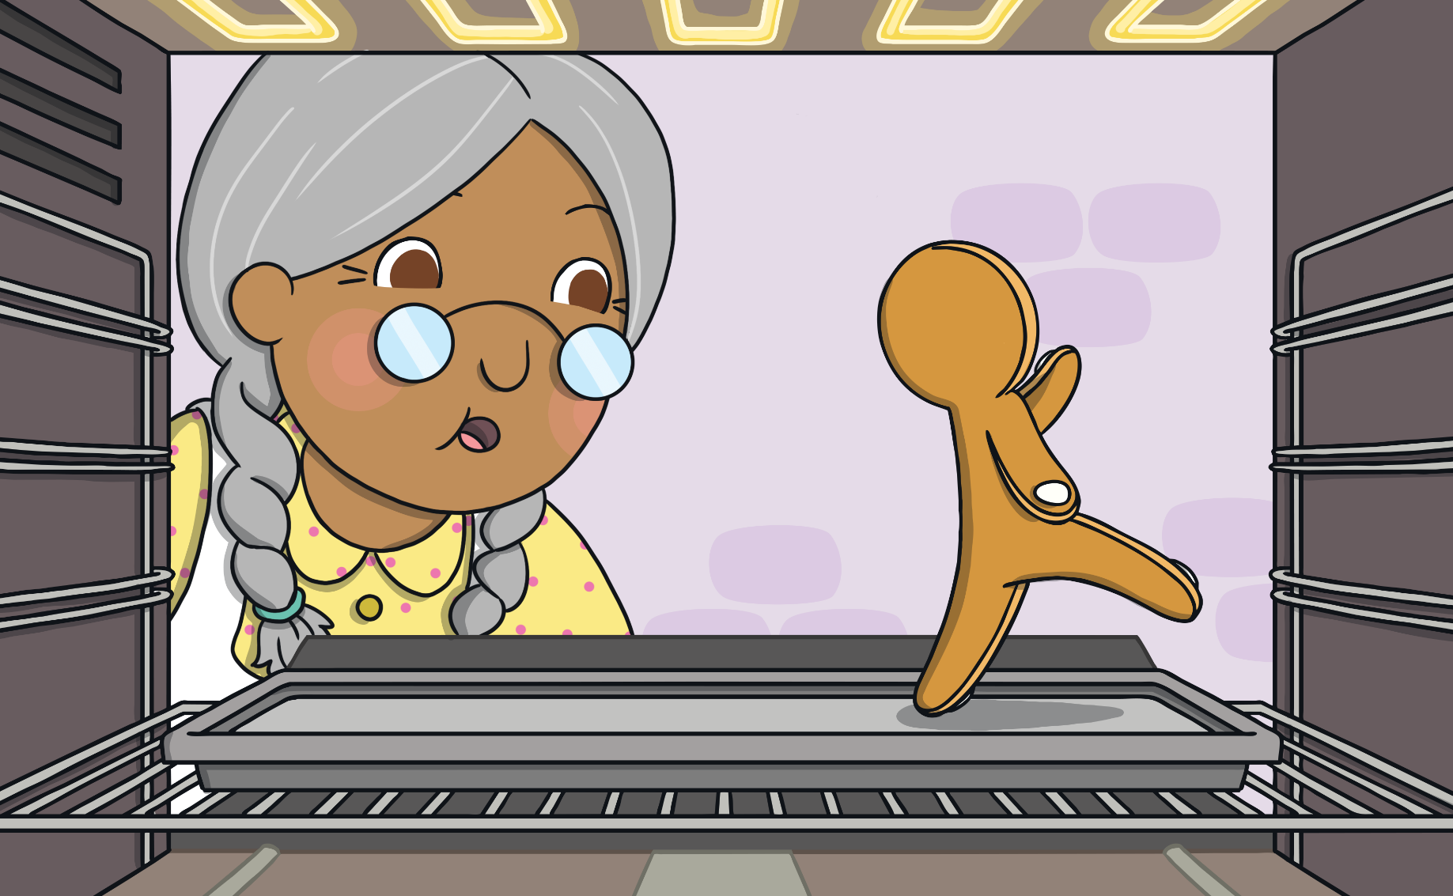
When she opened the oven, the Gingerbread Man jumped off the baking tray and ran out of the house!

Slide 5
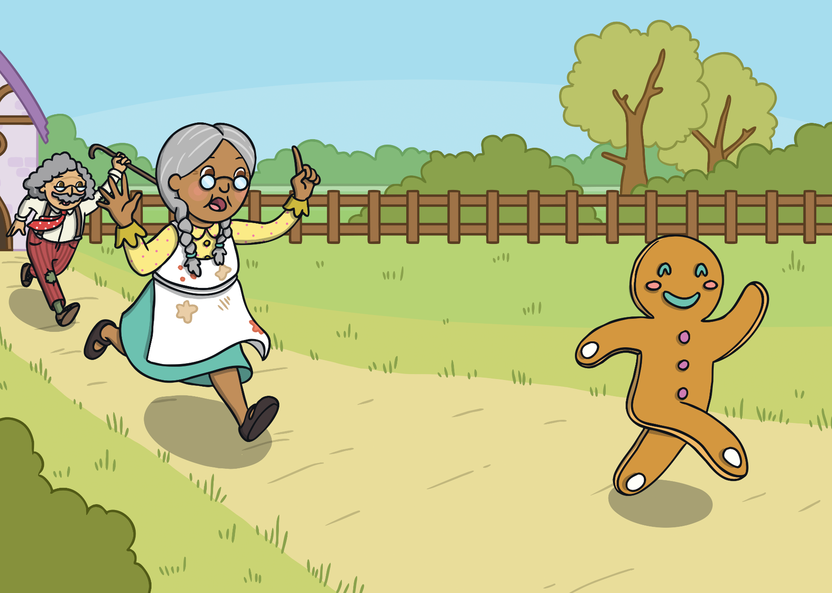
The little old woman and the little old man ran after the Gingerbread Man yelling, “Stop! Stop!” Sadly, they could not catch him.
The Gingerbread Man just laughed and said, “Run, run, as fast as you can! You can’t catch me, I’m the Gingerbread Man!”

Slide 6
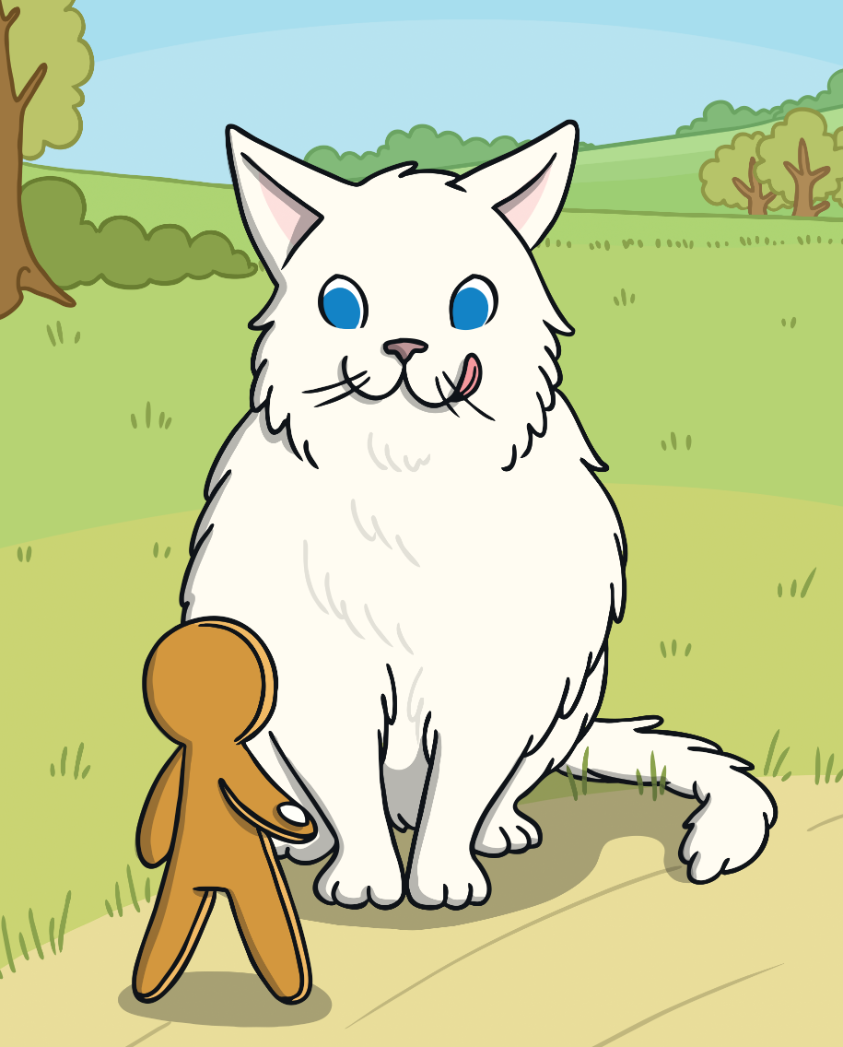
The Gingerbread Man ran until he came to a cat. “Stop! You look good enough to eat!” said the cat.

Slide 7
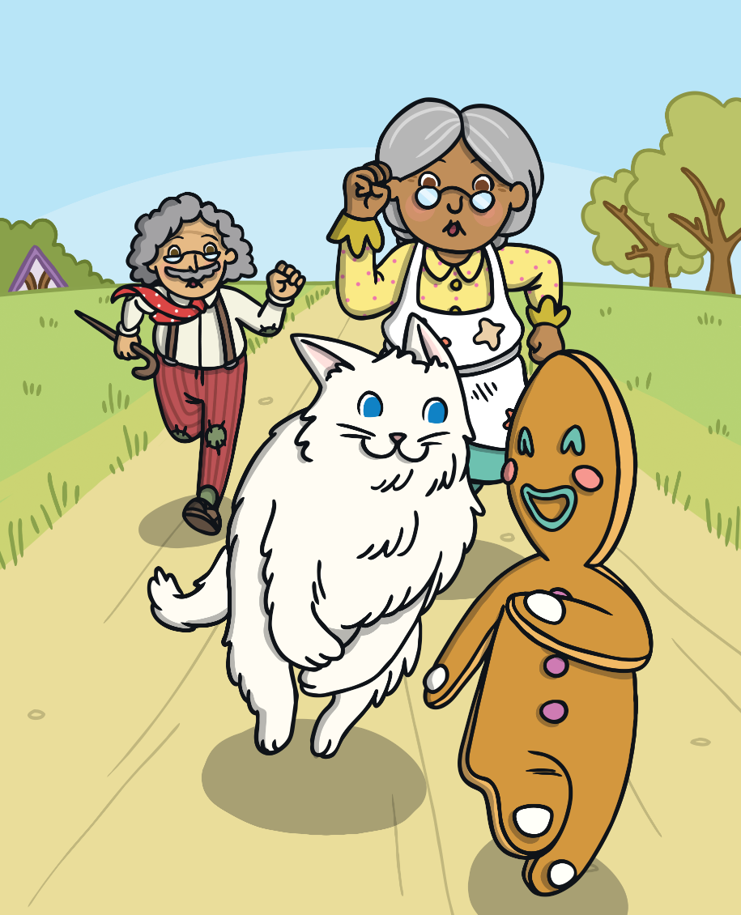
The Gingerbread Man just laughed and said, “Run, run, as fast as you can! You can’t catch me, I’m the Gingerbread Man!”

Slide 8
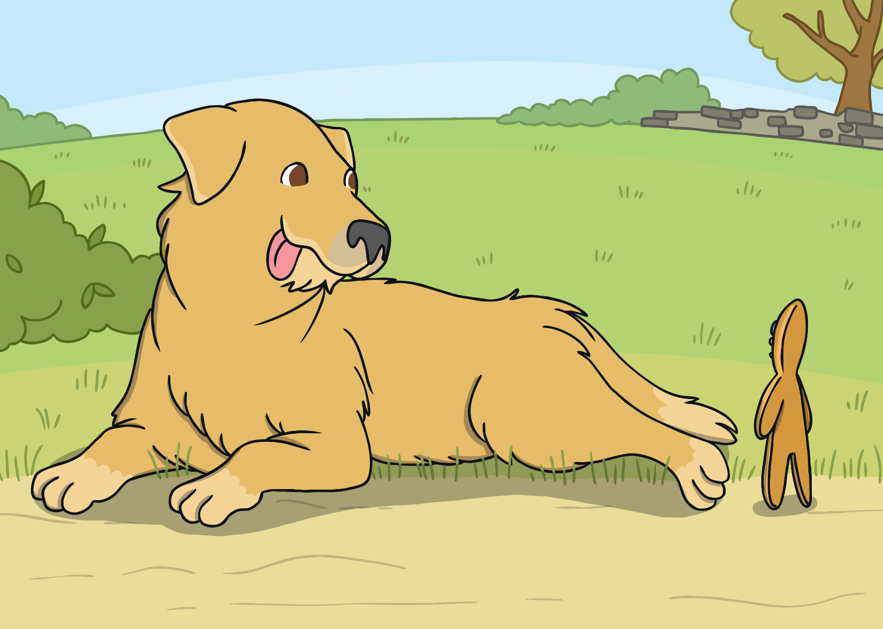
The Gingerbread Man ran until he came to a dog. “Stop! You look good enough to eat!” said the dog.

Slide 9
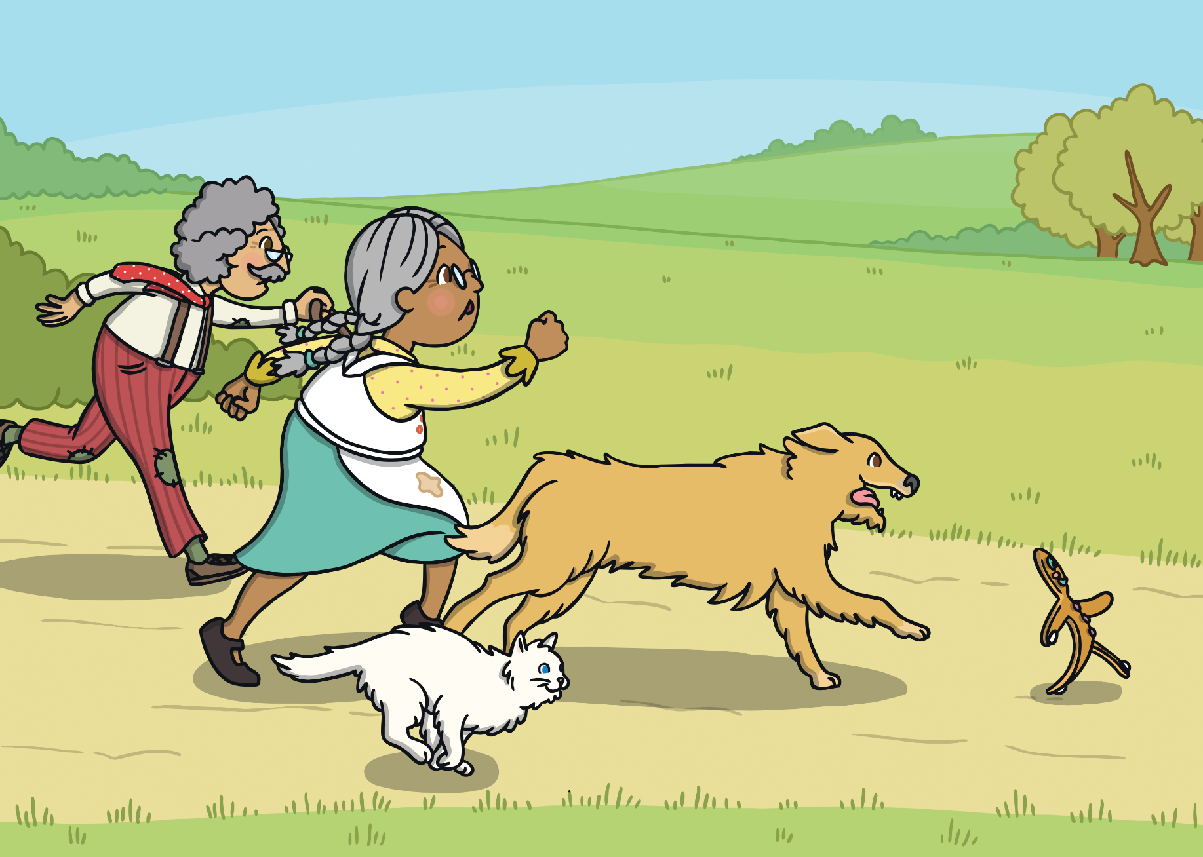
The Gingerbread Man just laughed and said, “Run, run, as fast as you can! You can’t catch me, I’m the Gingerbread Man!”

Slide 10
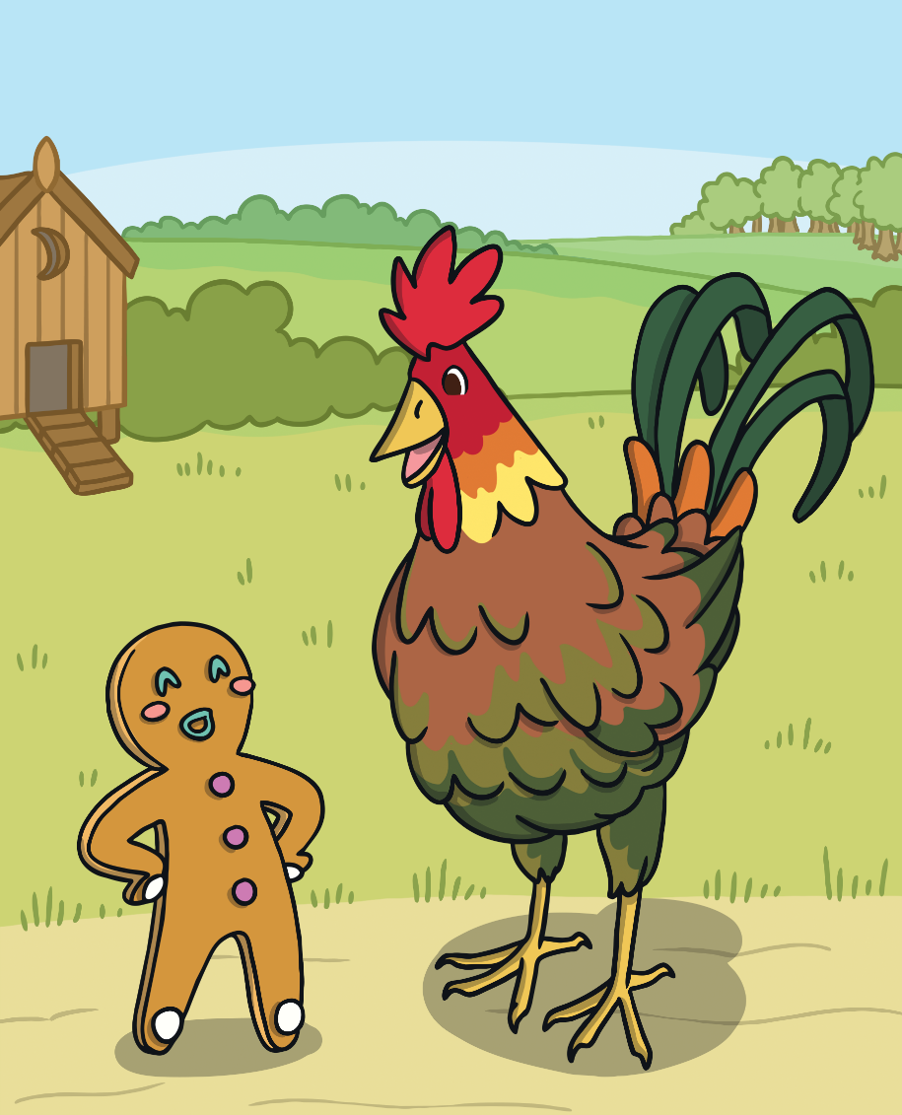
The Gingerbread Man ran on. Then he came to a cockerel. “Stop! You look good enough to eat!” said the cockerel.

Slide 11
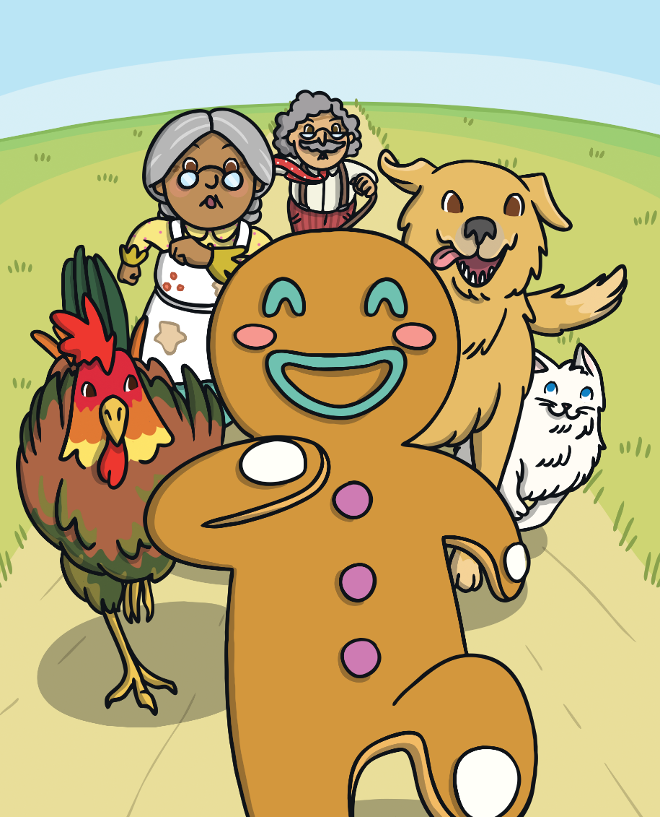
The Gingerbread Man just laughed and said, “Run, run, as fast as you can! You can’t catch me, I’m the Gingerbread Man!”

Slide 12
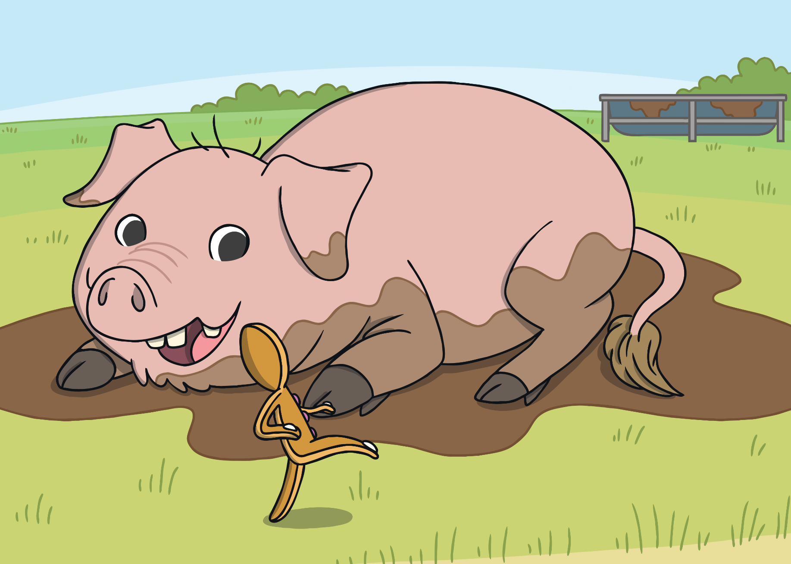
The Gingerbread Man ran down the lane and came to a pig. “Stop! You look good enough to eat!” said the pig.

Slide 13
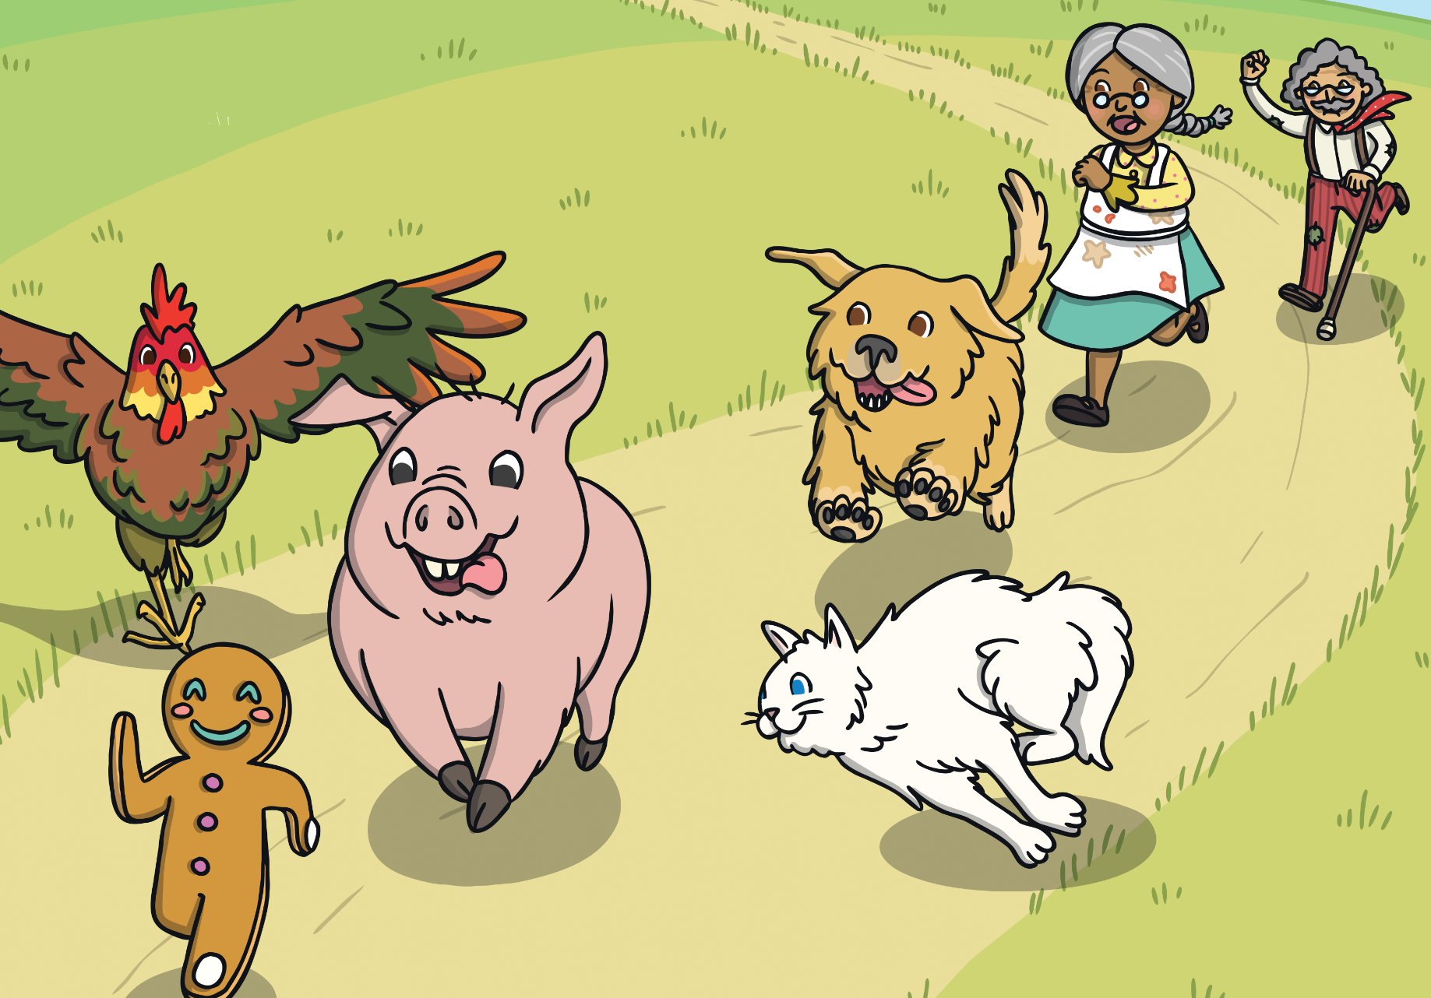
The Gingerbread Man just laughed and said, “Run, run, as fast as you can! You can’t catch me, I’m the Gingerbread Man!”

Slide 14
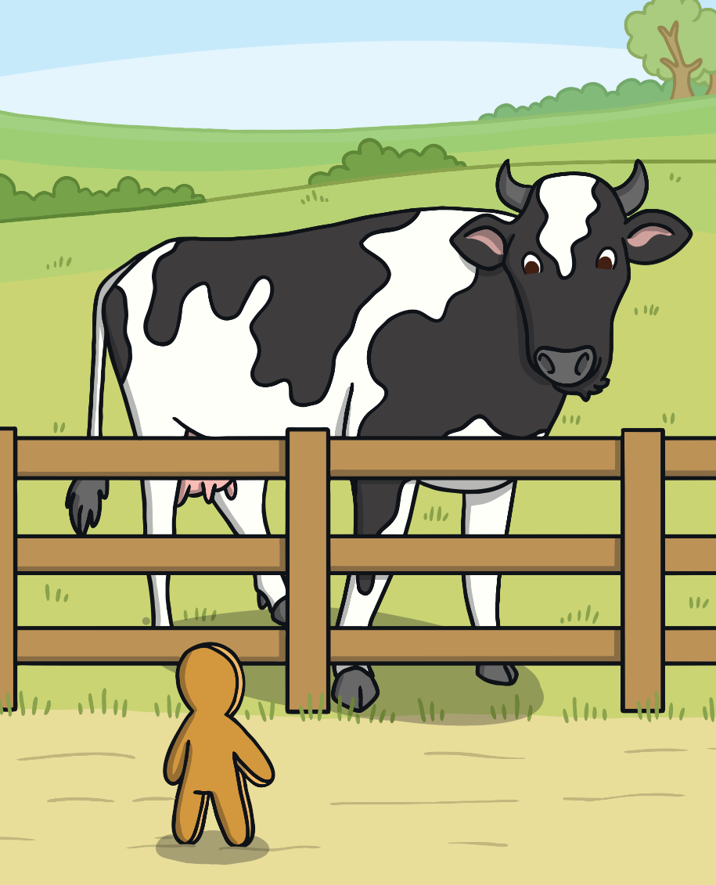
A little further on the Gingerbread Man came to a cow. “Stop! You look good enough to eat!” said the cow.

Slide 15
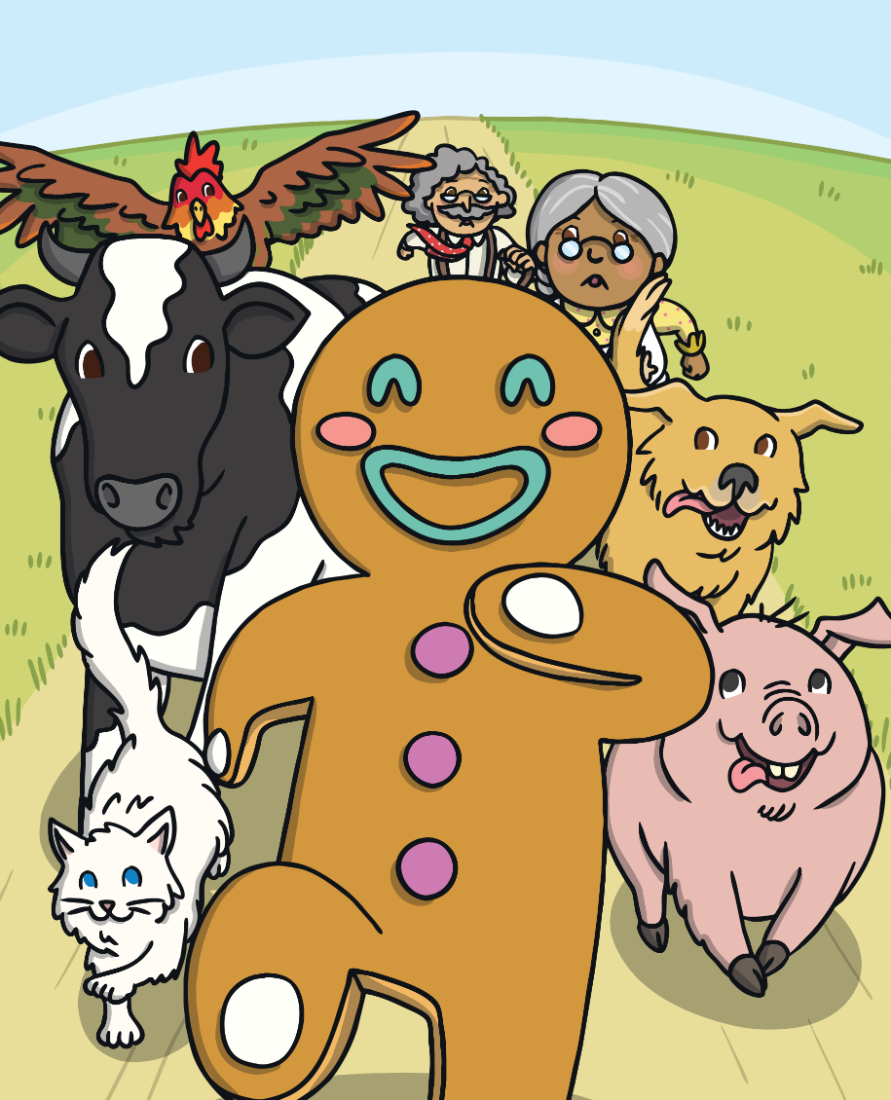
The Gingerbread Man just laughed and said, “Run, run, as fast as you can! You can’t catch me, I’m the Gingerbread Man!”

Slide 16
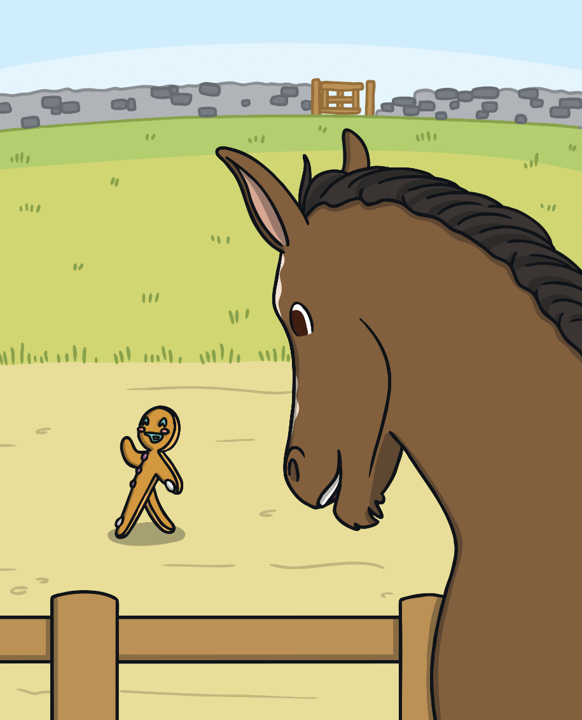
The Gingerbread Man ran on. Then he came to a horse. “Stop! You look good enough to eat!” said the horse.

Slide 17
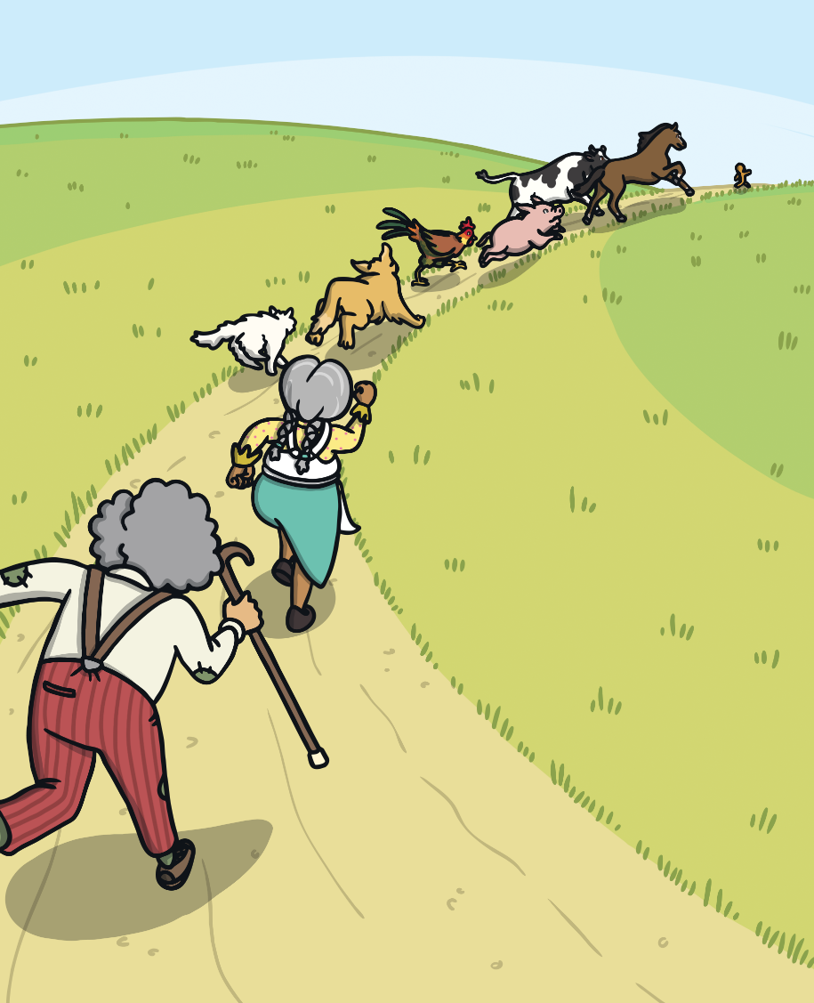
The Gingerbread Man just laughed and said, “Run, run, as fast as you can! You can’t catch me, I’m the Gingerbread Man!”

Slide 18
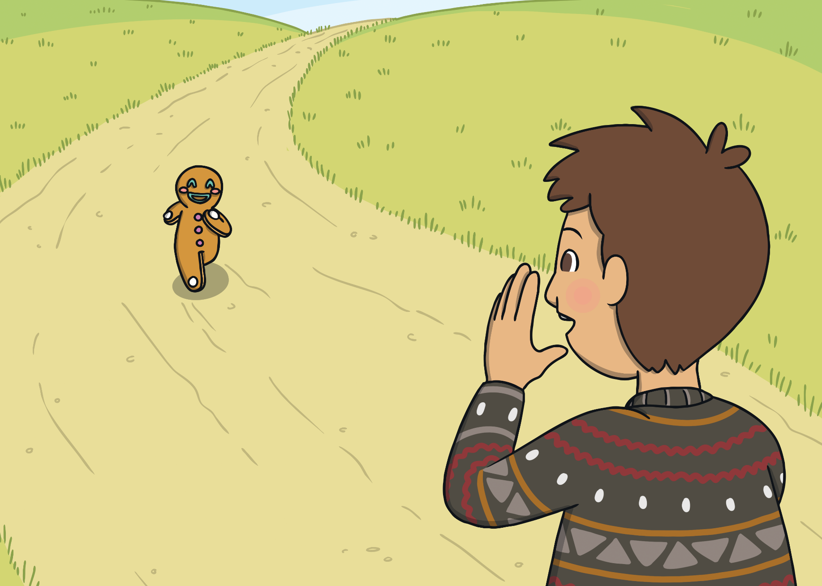
It was not long before the Gingerbread Man came to a boy. “Stop! You look good enough to eat!” said the boy.

Slide 19
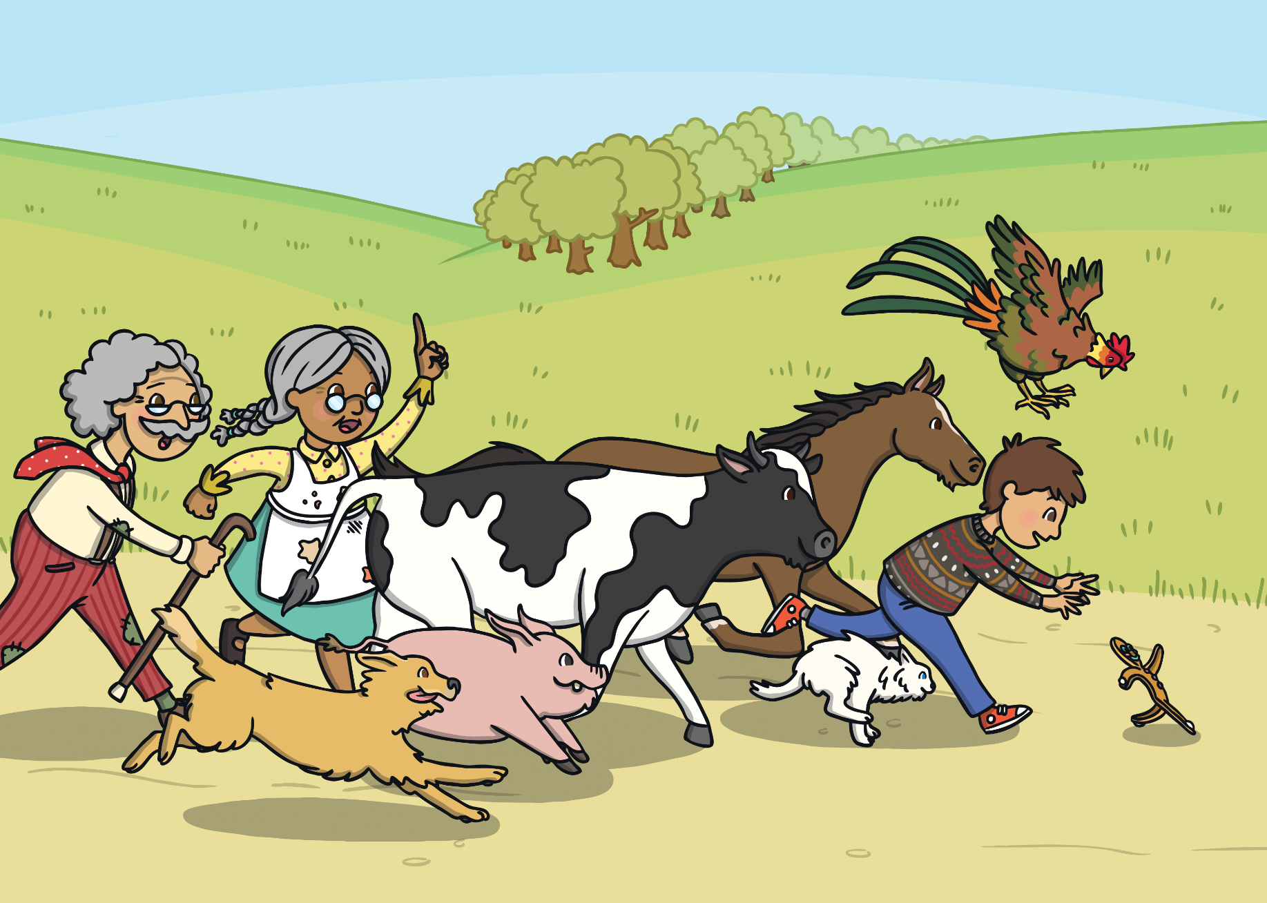
The Gingerbread Man just laughed and said, “Run, run, as fast as you can! You can’t catch me, I’m the Gingerbread Man!”

Slide 20
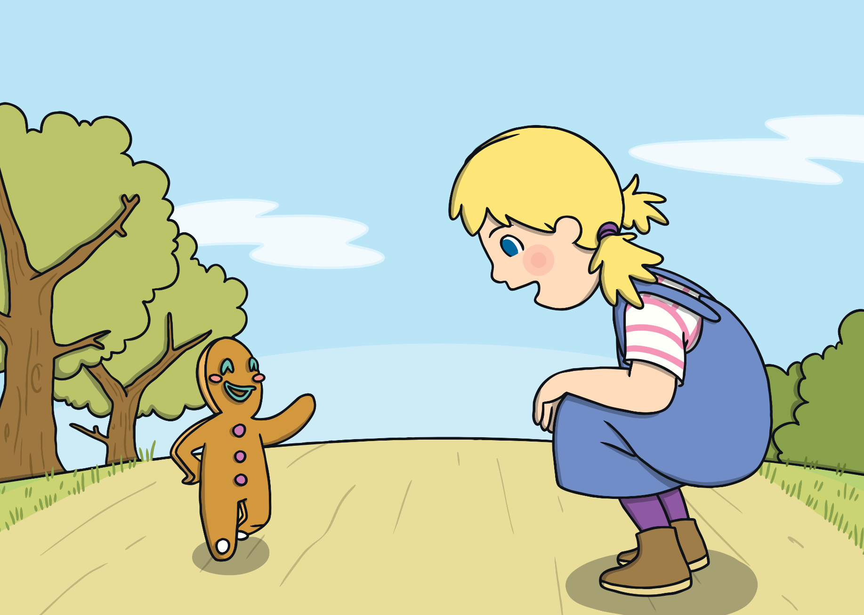
The Gingerbread Man kept running and came to a girl. “Stop! You look good enough to eat!” said the girl and she joined in the chase.

Slide 21
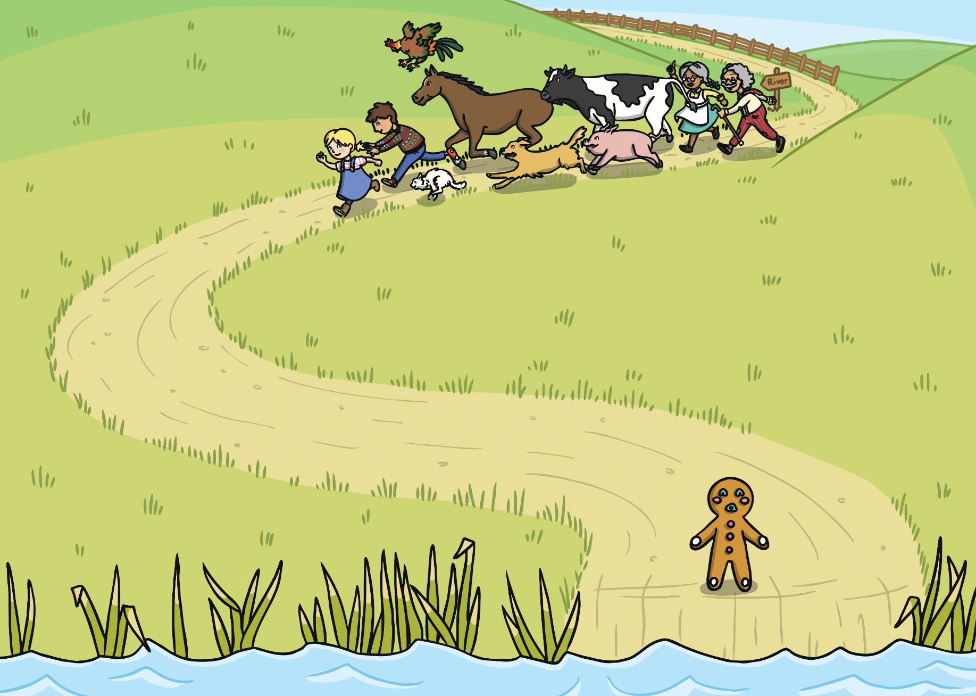
The Gingerbread Man ran on until he came to a river. He stopped as he could not swim!

Slide 22
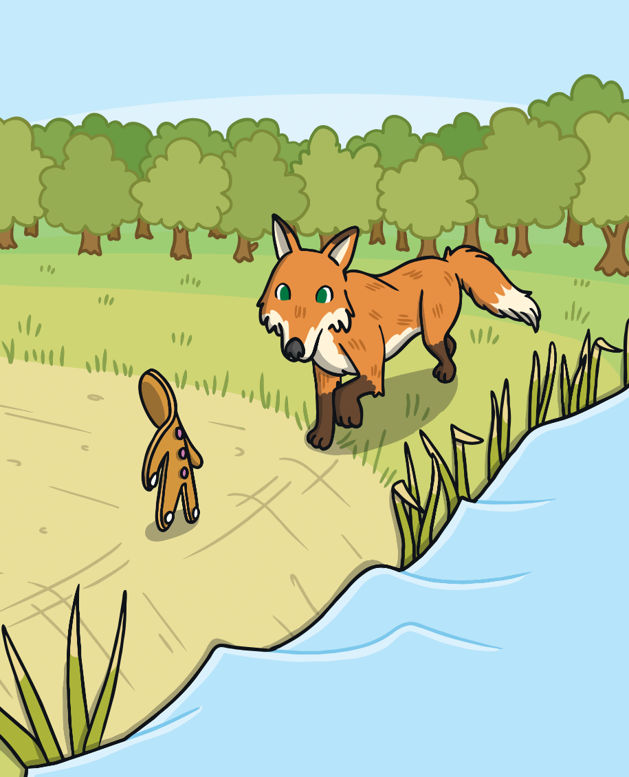
Just then, a fox came by. “I can help you cross the river,” said the fox. “Just hop onto my tail and I will swim across.”

Slide 23
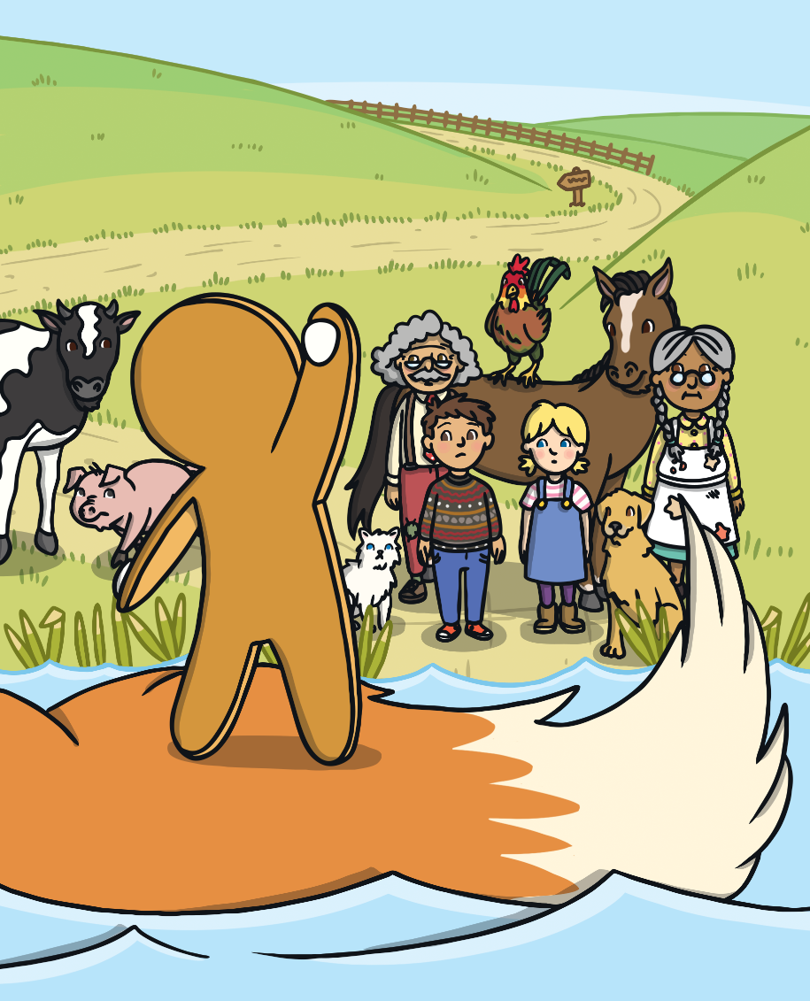
The Gingerbread Man saw the others coming. He knew that if he did not go with the fox, he would be eaten. So he jumped onto his tail.

Slide 24
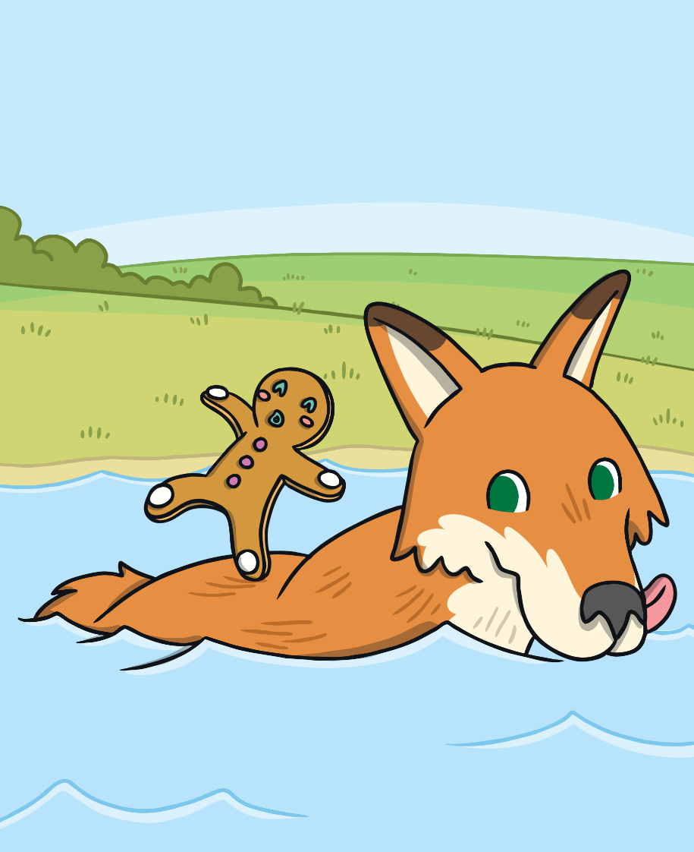
Soon the Gingerbread Man began to get wet. “Climb onto my back,” said the fox, so the Gingerbread Man did.

Slide 25
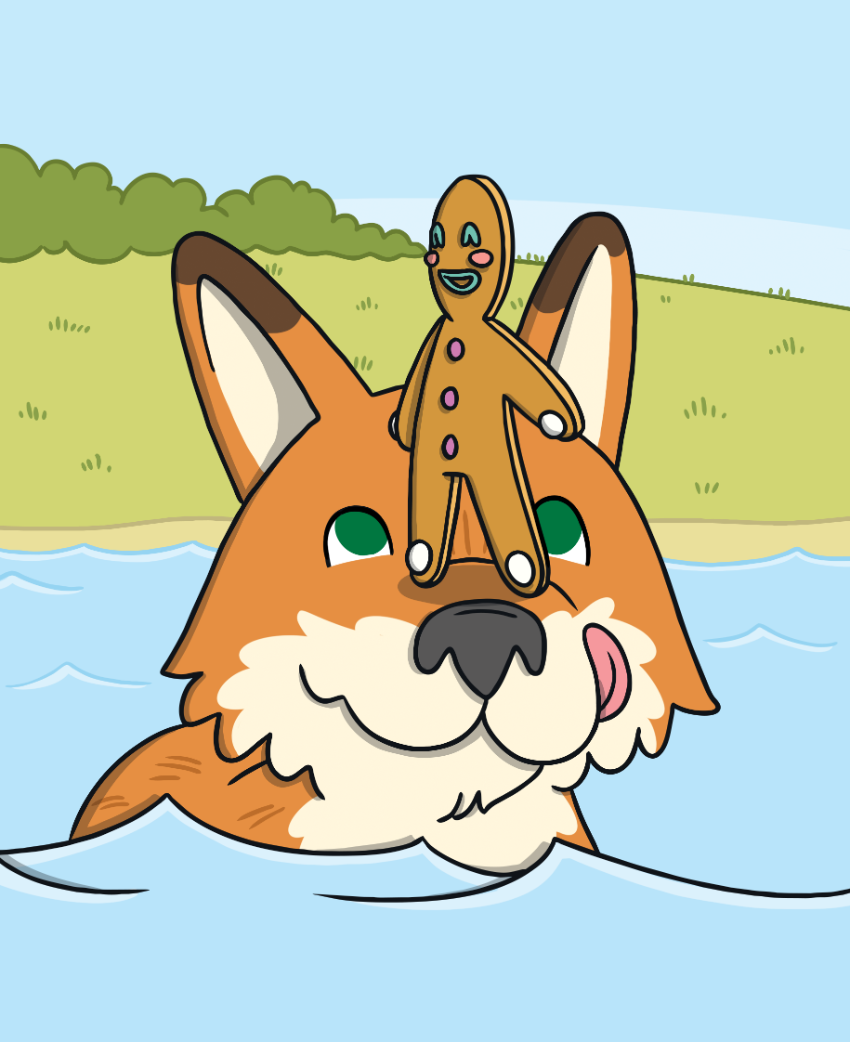
The water was getting even deeper. This time the fox said, “Jump onto my nose so that you don’t get wet.” The Gingerbread Man climbed onto the tip of his nose.

Slide 26
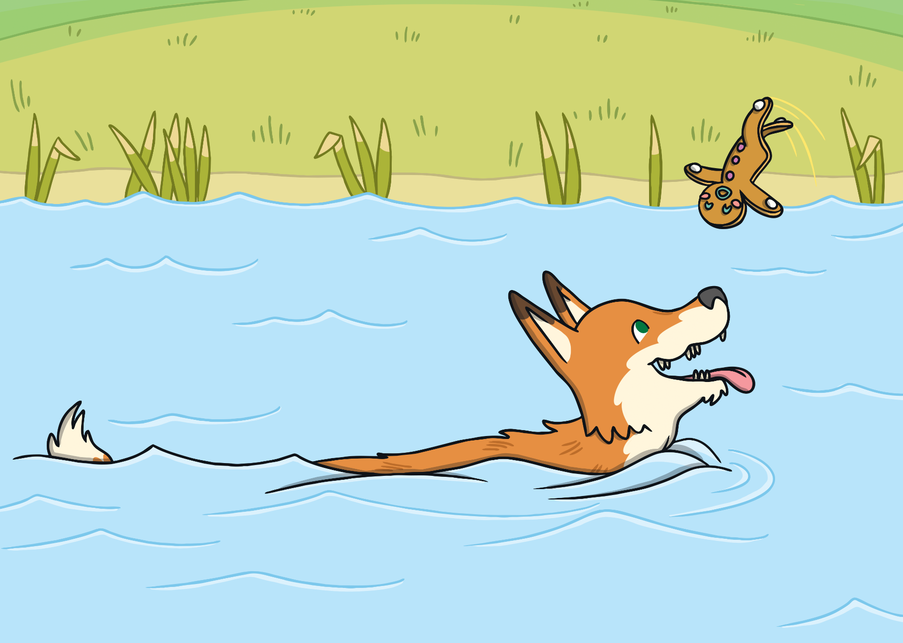
Just then, the fox tipped back his head and the Gingerbread Man flew into the air.
The fox opened his mouth and SNAP! That was the end of the Gingerbread Man.

